Slide 1

BANK LOAN ANALYTICS DASHBOARD
By – Debasmita Pathak
Student code – AF05150011

Slide 2
Presentation Flow
1. Introduction
5.Data Modeling
9.Dashboard Overview
2. Project Objective
6.Dax Measures
10. Conclusion
3. Dataset Overview
7.KPI &Chart Analysis
11. Future Scope
4. Data Cleaning
8. Slicers
12. References

Slide 3

Introduction
A Bank Loan Analytics Dashboard in Power BI transforms raw lending and financial data into interactive, real-time insights. It enables bank management and risk teams to track critical KPIs (like total funded amounts, average interest rates, and loan statuses), monitor portfolio health, and evaluate default risks.

Slide 4

Project Objective
Portfolio Performance & KPIs
Risk Management
Time-Based Analysis
Borrower Analysis
Geographical Insights

Slide 5

Dataset Overview
This bank loan dataset that contains 38,577 loan records and 23 columns. It is designed for analyzing loan applications, borrower profiles, loan performance, and repayment behavior.
This Dataset Contains:
Loan Information | ISSUE_DATE, LOAN_AMOUNT, TERM, PURPOSE, GRADE, SUB_GRADE
Borrower Information | EMP_LENGTH, EMP_TITLE, ANNUAL_INCOME, HOME_OWNERSHIP, VERIFICATION_STATUS
Financial Metrics, Payment Dates | INT_RATE, DTI, INSTALLMENT, TOTAL_PAYMENT, LAST_PAYMENT_DATE, NEXT_PAYMENT_DATE, LAST_CREDIT_PULL_DATE

Slide 6
Data Cleaning
Why did I clean the Data ?
I cleaned the data to ensure accurate analysis, improve dashboard performance, and create reliable visualizations in Power BI.
Steps:
Removed errors
Checked missing values
Converted data types
Renamed columns
Data Cleaning
Performed using Power Query

Slide 7
KPI Analysis
KPI Card | Description
Total Loan Application: 38,576 | Total number of loan applications received in the selected period. Measures demand and marketing effectiveness.
Total Funded Amount: 436M | The total principal amount disbursed to approved borrowers. Represents the bank's total loan exposure.
Sum of TOTAL_PAYMENT: 473M | The total amount collected from borrowers including principal + interest. Used to track portfolio recovery and revenue.
Average Interest Rate: 12.05% | The average interest rate charged across all active loans. Key driver of profitability for the bank.
Average DTI Ratio: 13.33% | Average Debt-to-Income ratio of borrowers. Lower DTI indicates lower borrower risk. Industry benchmark is < 36%.

Slide 8
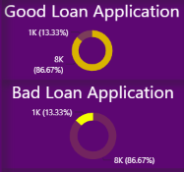
Chart Analysis
Metric | Insight
Approval Rate for Good Loans | Only 86.67%
Rejection Rate for Bad Loans | 13.33%
Leakage | 13.33% bad loans got approved
Missed Opportunity | 86.67% good loans rejected

Slide 9
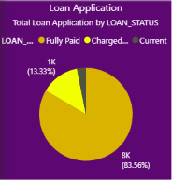
83.56% Loans Fully Paid.
This means collection and recovery are working well.Most customers are paying EMIs on time and closing their loans. This is a big positive for the bank.
13.33% Loans Charged Off = 1K LoansThis is the NPA Rate.
"Current" loans are only 3.11%.
This means there are very few loans with active EMIs running right now.

Slide 10
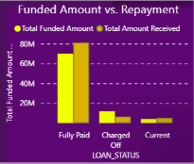
LOAN_STATUS | Funded Amount | Amount Received
Fully Paid | ∼70M | ∼80M
Charged Off | ∼12M | ∼5M
Current | ∼6M | ∼4M

Slide 11
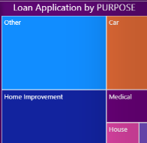
Business Takeaways
Categorization Issue: "Other" being the biggest is a red flag. You're missing insights because ∼30-40% of loans aren't classified properly. Recommend cleaning purpose categories.
Top Demand Drivers: Home Improvement + Car together are the 2nd and 3rd biggest. Marketing campaigns can target these 2.
Risk Check: Medical and "Other" loans often have higher default risk. Cross-check with your Charged Off data from the first chart.

Slide 12
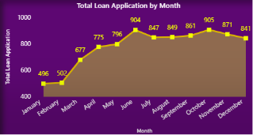
Business Takeaways
Seasonality: 2 peaks → june and october. These are your high-demand months. Plan marketing budget + staff capacity here.
Slow months: jan-feb are 45% lower than oct. Use these months for processing backlogs or targeted campaigns.
Growth story: from jan 496 to oct 905 = +82% growth in 10 months. Strong upward trend overall.
No big drop-off: after june peak, it stabilizes around 840-870. Demand is consistent in H2.

Slide 13
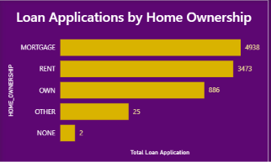
Business Takeaways
Target Segment: 89.8% of applications come from MORTGAGE + RENT. Marketing can focus here.
Risk View: Renters = 37%. Banks usually see them as higher risk vs OWN/MORTGAGE. You might want to check default rates for RENT vs MORTGAGE.
Low Volume: OWN and NONE are very low. Opportunity to run campaigns for homeowners without loan.

Slide 14
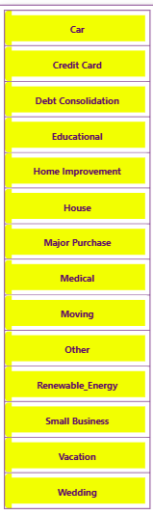
Slicers
"Loan Purpose Slicer“
This slicer allows users to segment the entire dashboard by the borrower’s stated reason for taking the loan. It covers 14 categories such as Debt Consolidation, Home Improvement, Major Purchase, Renewable Energy, and Vacation. This helps stakeholders identify which loan purposes drive the highest volume, default rate, and revenue.
Use this slicer to filter the dashboard by the purpose of the loan. Categories include Car, House, Credit Card, Small Business, Wedding, Education, Medical, and more. Select one or multiple purposes to analyze trends for specific loan types.

Slide 15
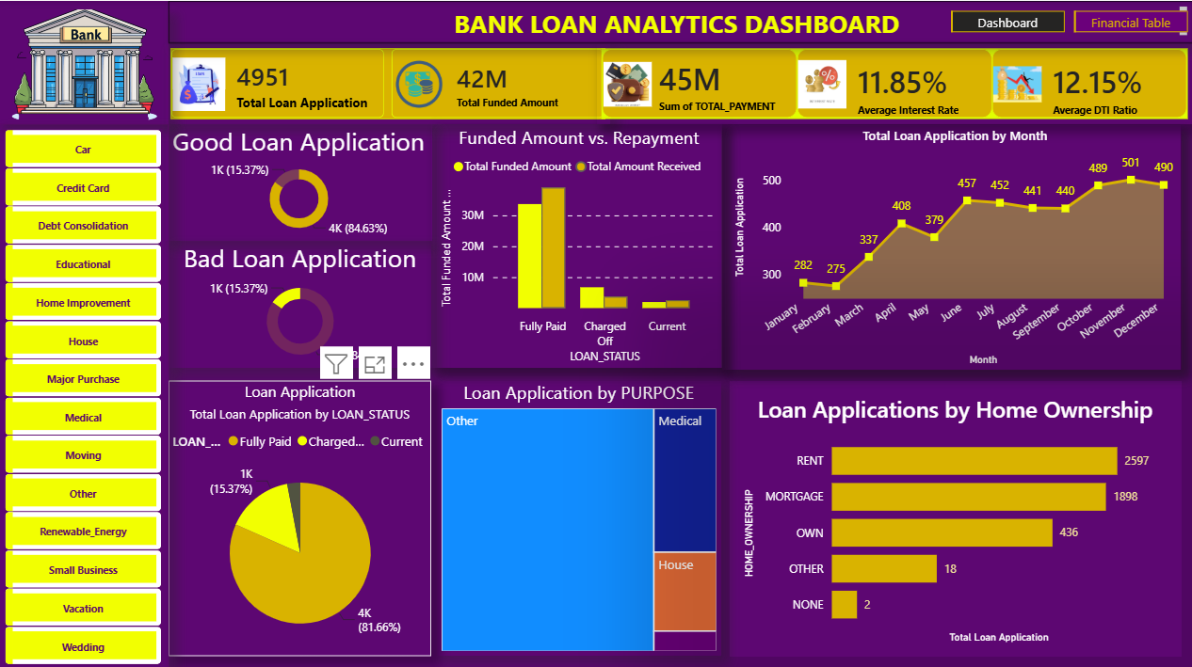
Dashboard Overview
The dashboard provides visual analytics to identify suspicious activities efficiently.
Trends & Forecasting
Cumulative Funded vs Received - Area chart to see if gap is widening
MoM Growth % next to "Total Loan Application by Month“
Forecast for next 3 months using the trend line

Slide 16

Conclusion
The conclusion should summarize the overall portfolio health, distinguishing between "Good Loans" (fully paid/current) and "Bad Loans" (charged off/late). It must highlight actionable insights regarding borrower profiles and regional trends to mitigate risks and improve future lending strategies.

Slide 17

Future Scope
The future scope of a Bank Loan Analytics Dashboard in Power BI involves shifting from historical reporting to predictive risk modeling, real-time loan processing automation, and AI-driven customer segmentation. It will evolve from a simple overview into an active decision-making tool.

Slide 18



